Slide 1







Web Programming 2X1
JavaScript Runtime Model

Slide 2
Outcomes
Students should understand the following outcomes, upon successful completion of this module:
JavaScript Engine
Understanding the JavaScript Runtime Model
The Event Loop

Slide 3
The JavaScript Engine
A JavaScript engine is simply a computer program that executes JavaScript code.
It is responsible for translating human-readable JavaScript code into machine-readable instructions that the computer's hardware can execute.
When you write JavaScript code and run it in a browser, the code doesn't directly interact with your computer's hardware.
Instead, it interacts with the JavaScript engine, which acts as an intermediary between your code and the underlying machine.
Every browser has its own JS engine, but the most well known one is Google's v8 Engine.

Slide 4
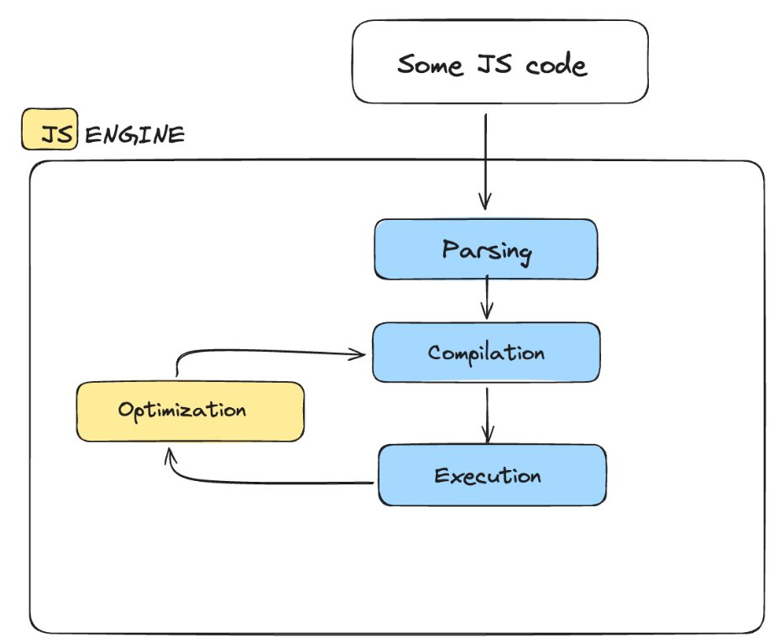
The JavaScript Engine
How the JS engine works:

Slide 5
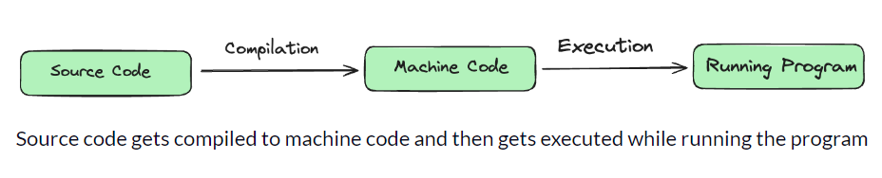
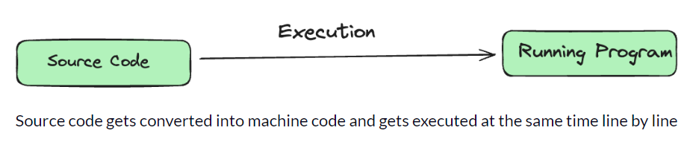
Compilation vs Interpretation
During compilation, the entire code is converted into machine code at once and written in a binary file that can be executed by a computer:
In interpretation, the interpreter runs through the source code and executes it line by line.
The code still needs to get converted into machine code, but this time it is happening line by line while executing the program:

Slide 6
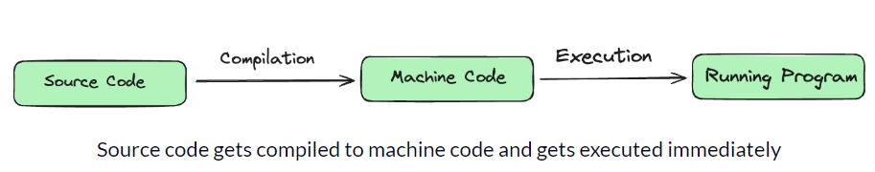
JIT Compilation
JS used to be a purely interpreted language.
But the modern JS engine now use a mix of compilation and interpretation which is known as "just-in-time“ - JIT compilation
In JIT compilation, the entire code is converted into machine code at once and then executed immediately.

Slide 7
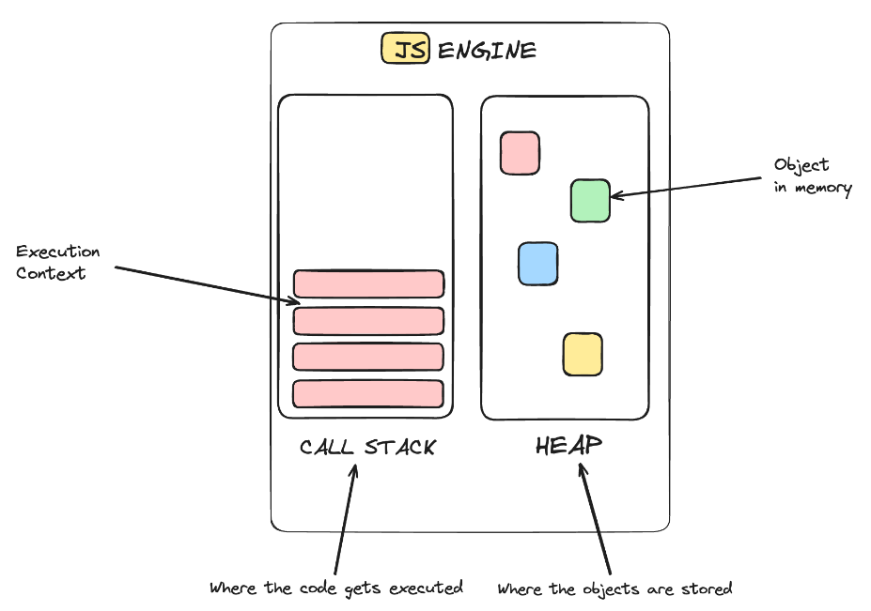
JIT Compilation
How JIT compilation works:

Slide 8
JavaScript Event Loop
The JavaScript event loop is a fundamental part of how JavaScript handles asynchronous operations and concurrency.
It is responsible for managing the execution of code, handling events, and ensuring that tasks are executed in the correct order.
How it works:
The event loop is like a manager that checks if the call stack is empty.
If it is, it takes tasks from the event queue and adds them to the call stack to be executed.
This allows JavaScript to handle things like timers and user interactions without stopping other tasks.

Slide 9
JavaScript Event Loop
Example:
The line of code console.log('Starting Node.js') is added to the call stack and prints Starting Node.js to the console. By doing so, it reaches the end of the log function and is removed from the call stack.

Slide 10
JavaScript Event Loop
The following line of code is a database query.
These tasks are immediately popped off because they may take a long time.
They are passed to Libuv, which asynchronously handles them in the background.
At the same time, Node.js can keep running other code without blocking its single thread.

Slide 11
JavaScript Event Loop
While Libuv handles the query in the background, our JavaScript is not blocked and can continue with console.log(”Before query result”).

Slide 12
JavaScript Event Loop
When the query is done, its callback is pushed to the I/O Event Queue to be run shortly*.*
The event loop connects the queue with the call stack.
It checks if the latter is empty and moves the first queue item for execution:

Slide 13







Thank You!
21
THE END
/belgiumcampusSA
#Belgium Campus
info@belgiumcampus.ac.za
+27 10 593 53 68
/belgiumcampus
www.belgiumcampus.ac.za
21

